Slide 1

Chapter 2 – part I

Slide 2
OUTLINE
  Displacement, time, and velocity.
  Acceleration.
  Motion with constant acceleration.

Slide 3
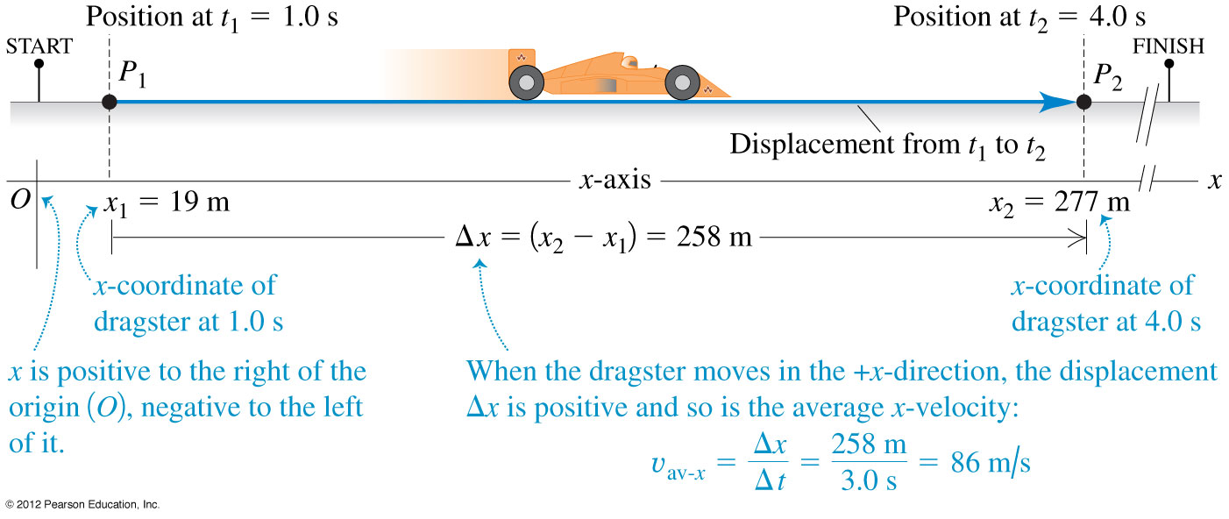
Displacement, time, and average velocity
  A particle moving along the x-axis has a coordinate x.
  The change in the particle’s coordinate is Δx = x₂ - x₁.
  The average x-velocity of the particle is v_{av-x} = Δx/Δt.

Slide 4
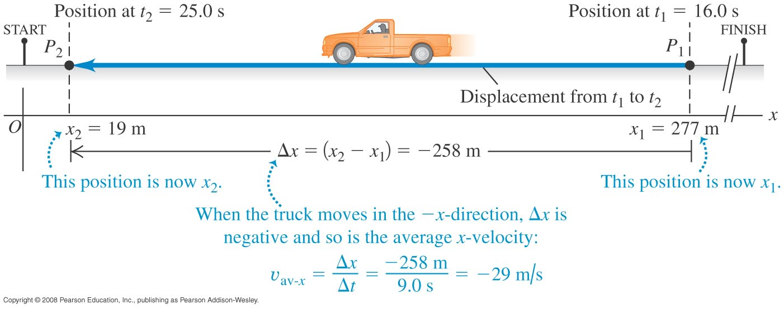
Negative velocity
The average x-velocity is negative during a time interval if the particle moves in the negative x-direction for that time interval.

Slide 5
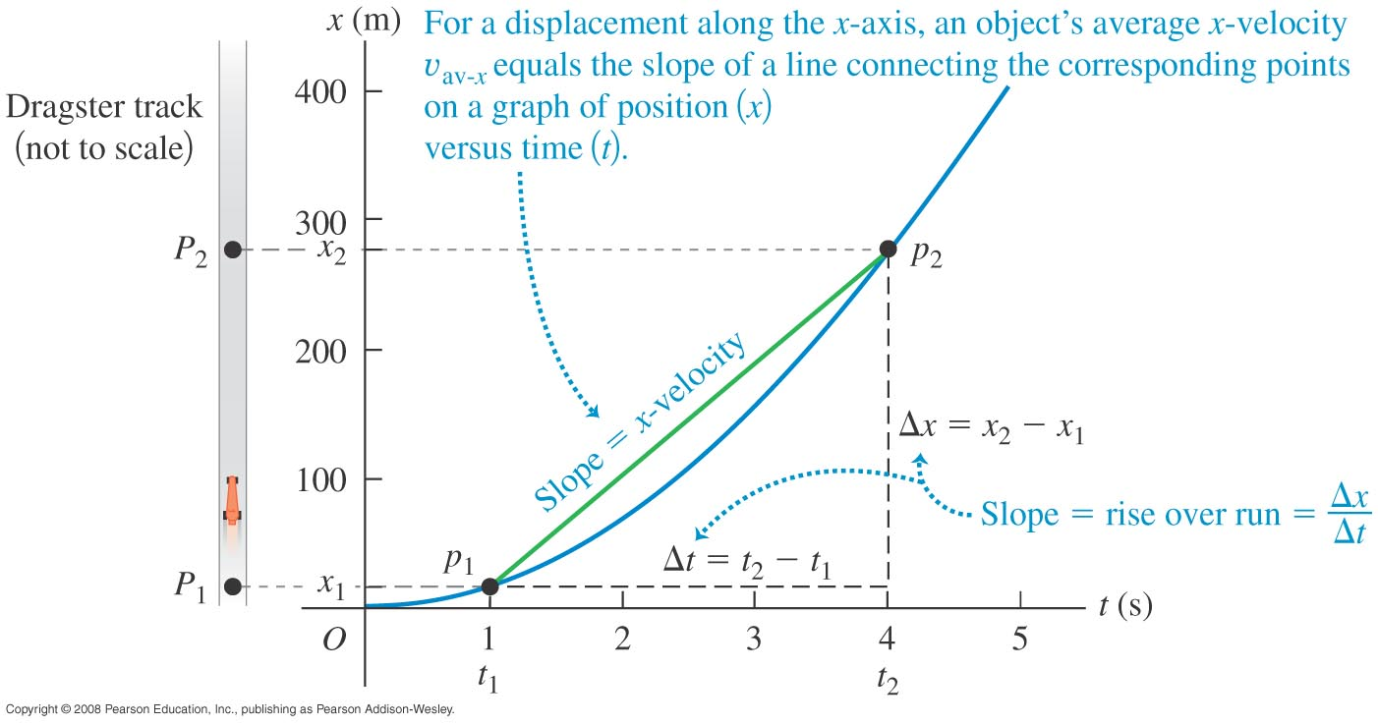
A position-time graph
  A position-time graph (an x-t graph) shows the particle’s position x as a function of time t.
  Figure shows how the average x-velocity is related to the slope of an x-t graph.

Slide 6
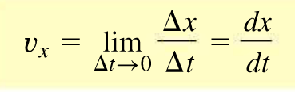
Instantaneous velocity
  The instantaneous velocity is the velocity at a specific instant of time or specific point along the path and is given by v_{x} = dx/dt.

Slide 7
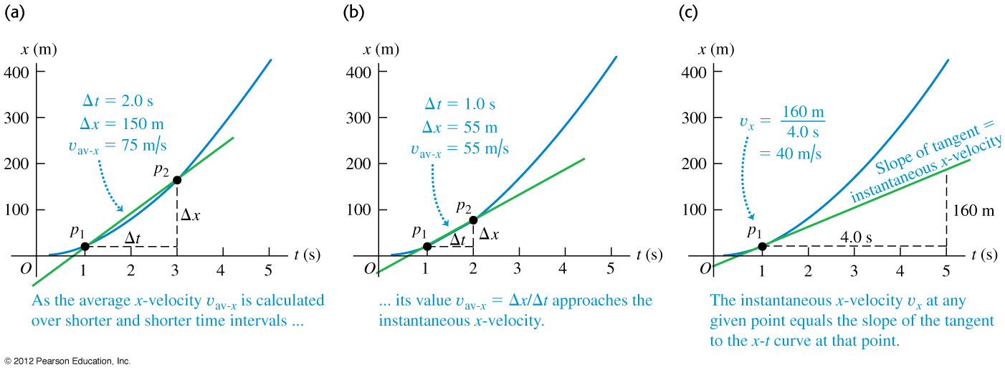
Finding velocity on an x-t graph
At any point on an x-t graph, the instantaneous x-velocity is equal to the slope of the tangent to the curve at that point.

Slide 8
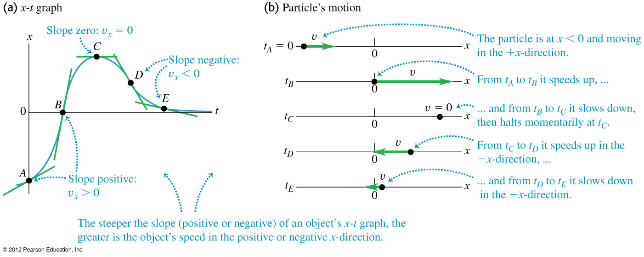
Motion diagrams
  A motion diagram shows the position of a particle at various instants, and arrows represent its velocity at each instant.
  Figure shows the x-t graph and the motion diagram for a moving particle.

Slide 9
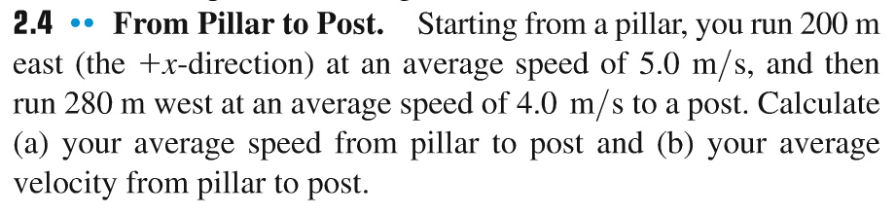
Problem #1

Slide 10
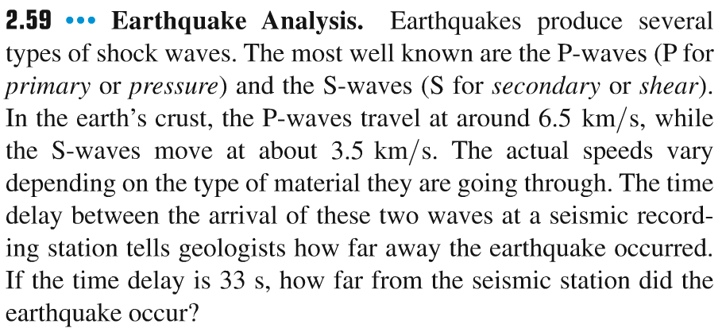
Problem #2

Slide 11
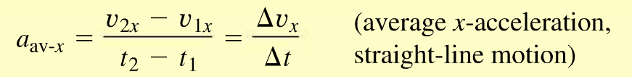
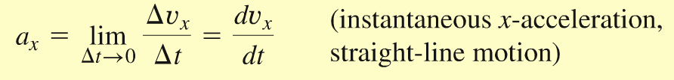
Acceleration
Acceleration describes the rate of change of velocity with time.
The average x-acceleration is a_{av-x} = Δv_{x}/Δt.
The instantaneous acceleration is a_{x} = dv_{x}/dt.

Slide 12
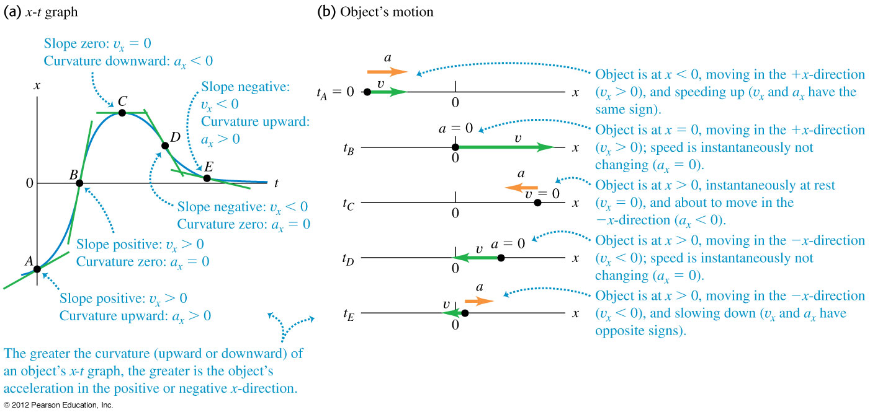
An x-t graph and a motion diagram
  Figure shows the x-t graph and the motion diagram for a particle.

Slide 13
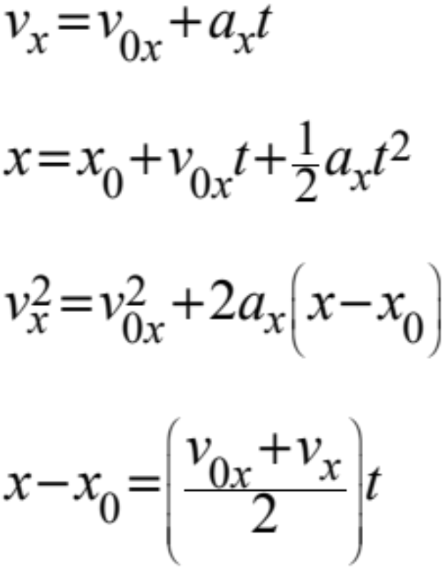
The equations of motion with constant acceleration
  The equations below apply to any straight-line motion with constant acceleration a_{x}.

Slide 14
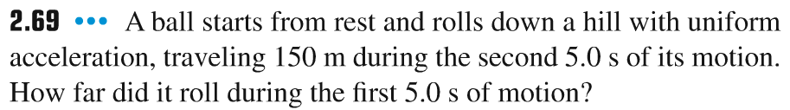
Problem #3

Slide 15
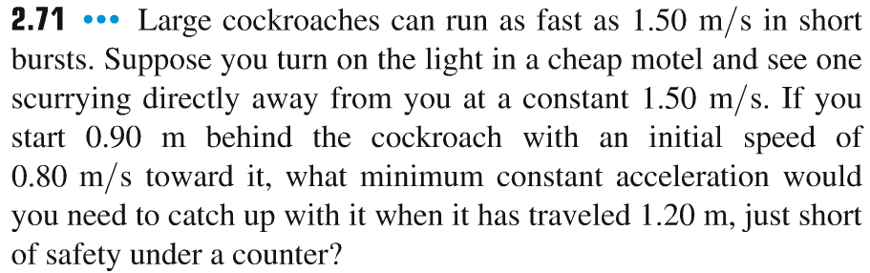
Problem #4

Slide 16
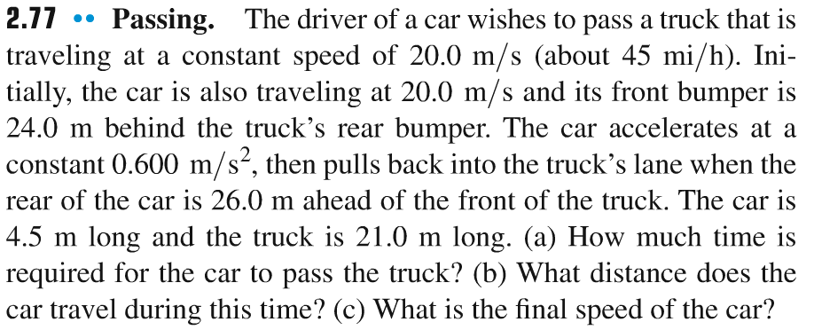
Problem #5

